Slide 1
Manual machine to ManuPlus to Evolution
10,000 Webster & Bennett vertical borers were built between 1887 and 1974 and sold all over the world. The youngest machines are now nearly 50 years old. They may look old but many are just tired. They have some wonderful quality features and many make perfect donor machines to be transformed into wonderful modern machines.
The first machines were operator controlled, hence the name ManuPlus but the full CNC possibilities were quickly seen and the
Evolution range was soon being purchased by major companies.
This process has been going on since 2004 and the latest machines have the latest digital developments – of course

Slide 2
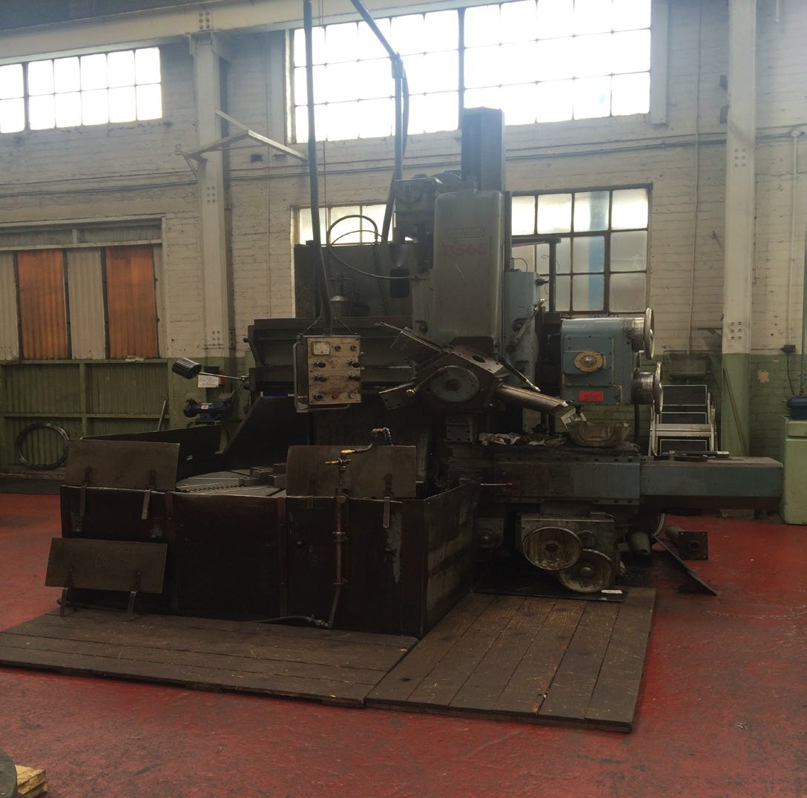
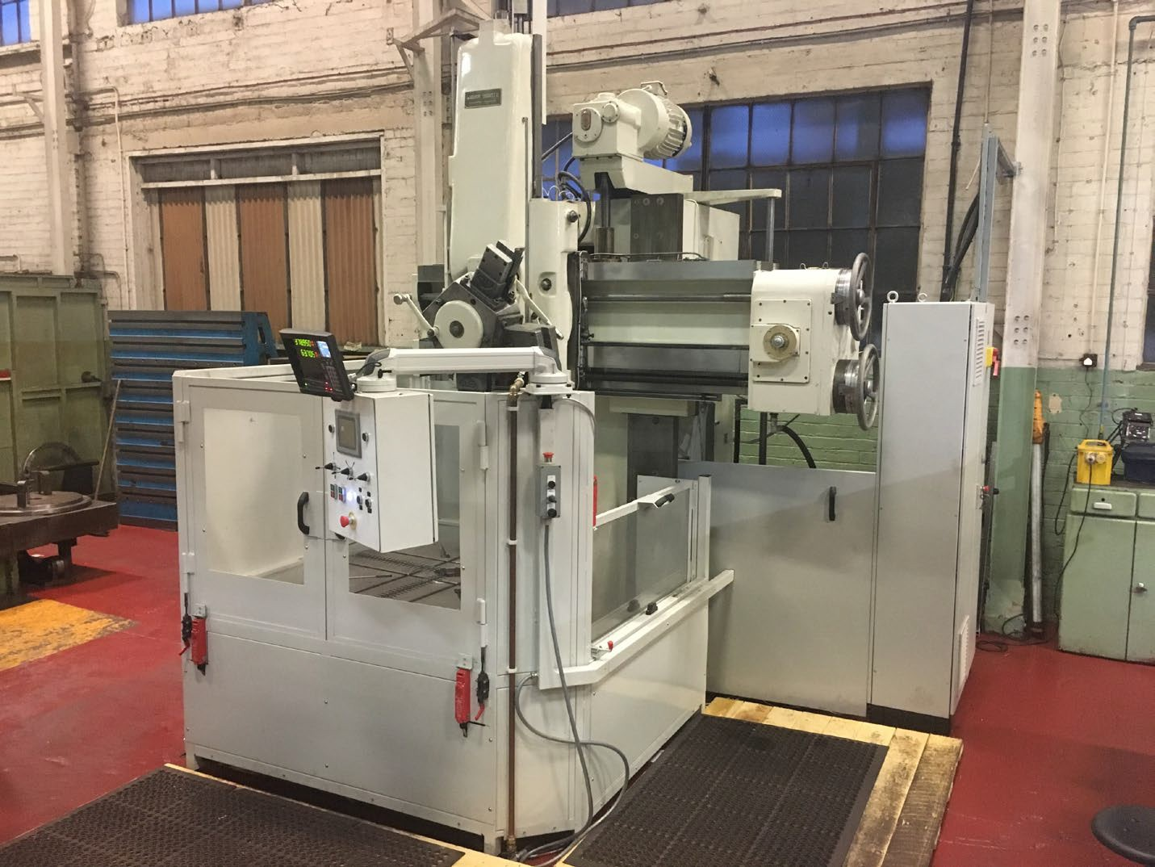
A ManuPlus - 50 YEARS OF HARD WORK, THANKS TO VTT-WB READY FOR ANOTHER 50
IS YOUR WEBSTER & BENNETT READY FOR THE VTT-WB TREATMENT?

Slide 3
RECYCLING AT HIGH LEVEL – THESE SUPERB CASTINGS AND ASSEMBLIES CAN BE RECYCLED PRESERVING GREAT VALUE AND AVOIDING NEW CASTING PROCESS POLLUTION
In 2004 we developed the first ManuPlus - an operator controlled machine. This was the first Manuplus was built for aero engine rebuild at Hong Kong Aero Engine Services the first of three machines
In 2004 we launched a program to use these ‘donor machines’ as the base for a new vertical turning centre – the Evolution
For both the ManuPlus and the Evolution ranges we turned donor machines into machines that were effectively ‘new’ and available at a price that reflected the savings of using the donor machine bodies
The Evolution rapidly became a serious contributor to the Webster & Bennett sales program as can be seen in the installations list
A photograph of the Evolution follows. Then a variety of ManuPlus models

Slide 4
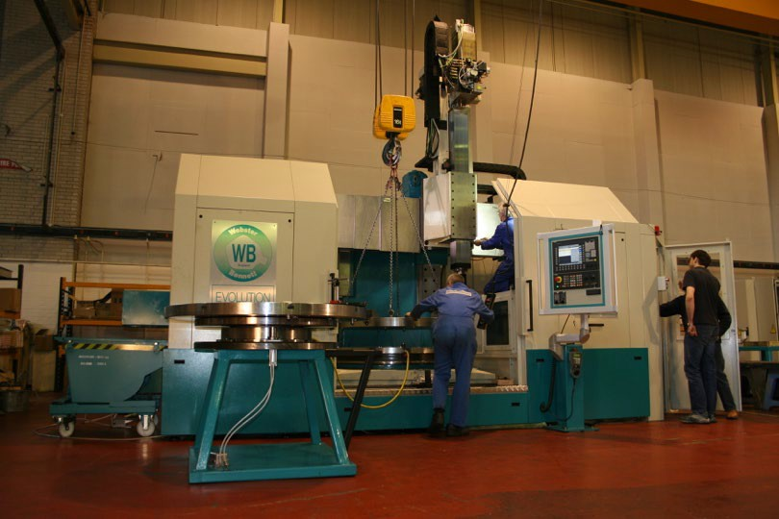
The original Webster & Bennett one piece body machines together with the totally reliable Timken bearings are not only great for conventional machine upgrades but are used also as donors to the
Evolution range of CNC machines.

Slide 5
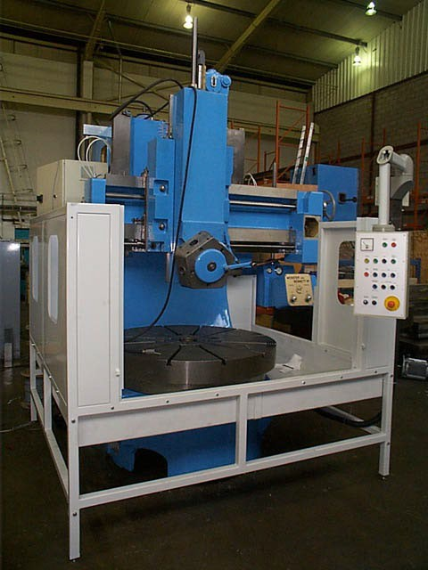
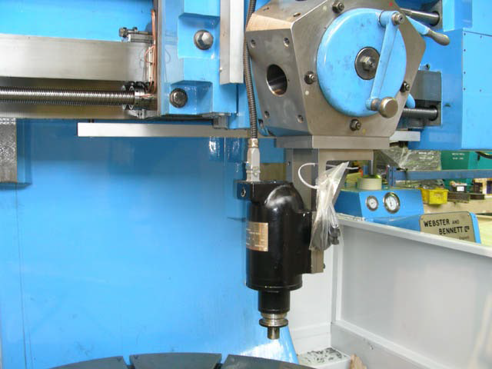
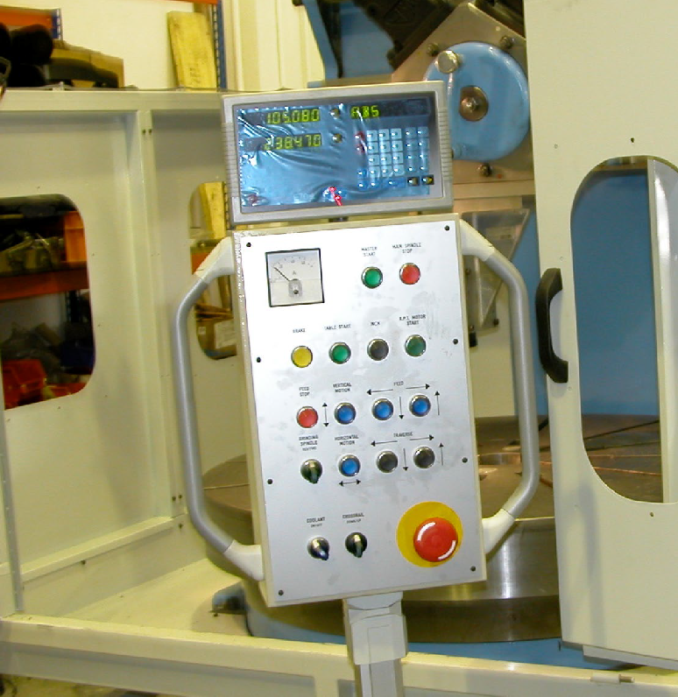
The first ManuPlus was for HAESL in 2004 and featured much improved operator control and high speed grinding application.

Slide 6
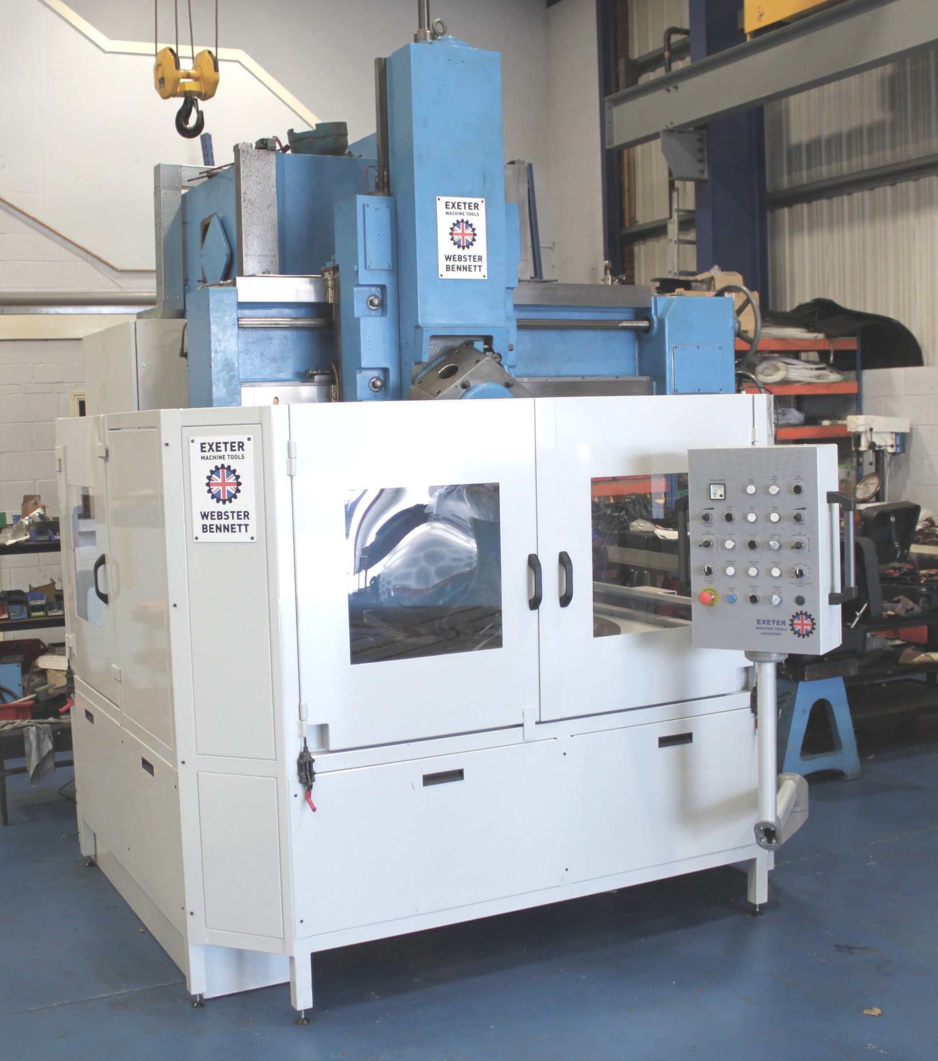
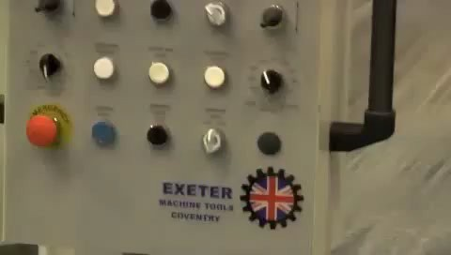
This is the third machine for HAESL in 2010. Click on the photo below to open the film that shows how much the controls had advanced. Since then it’s got better and even more operator friendly.

Slide 7
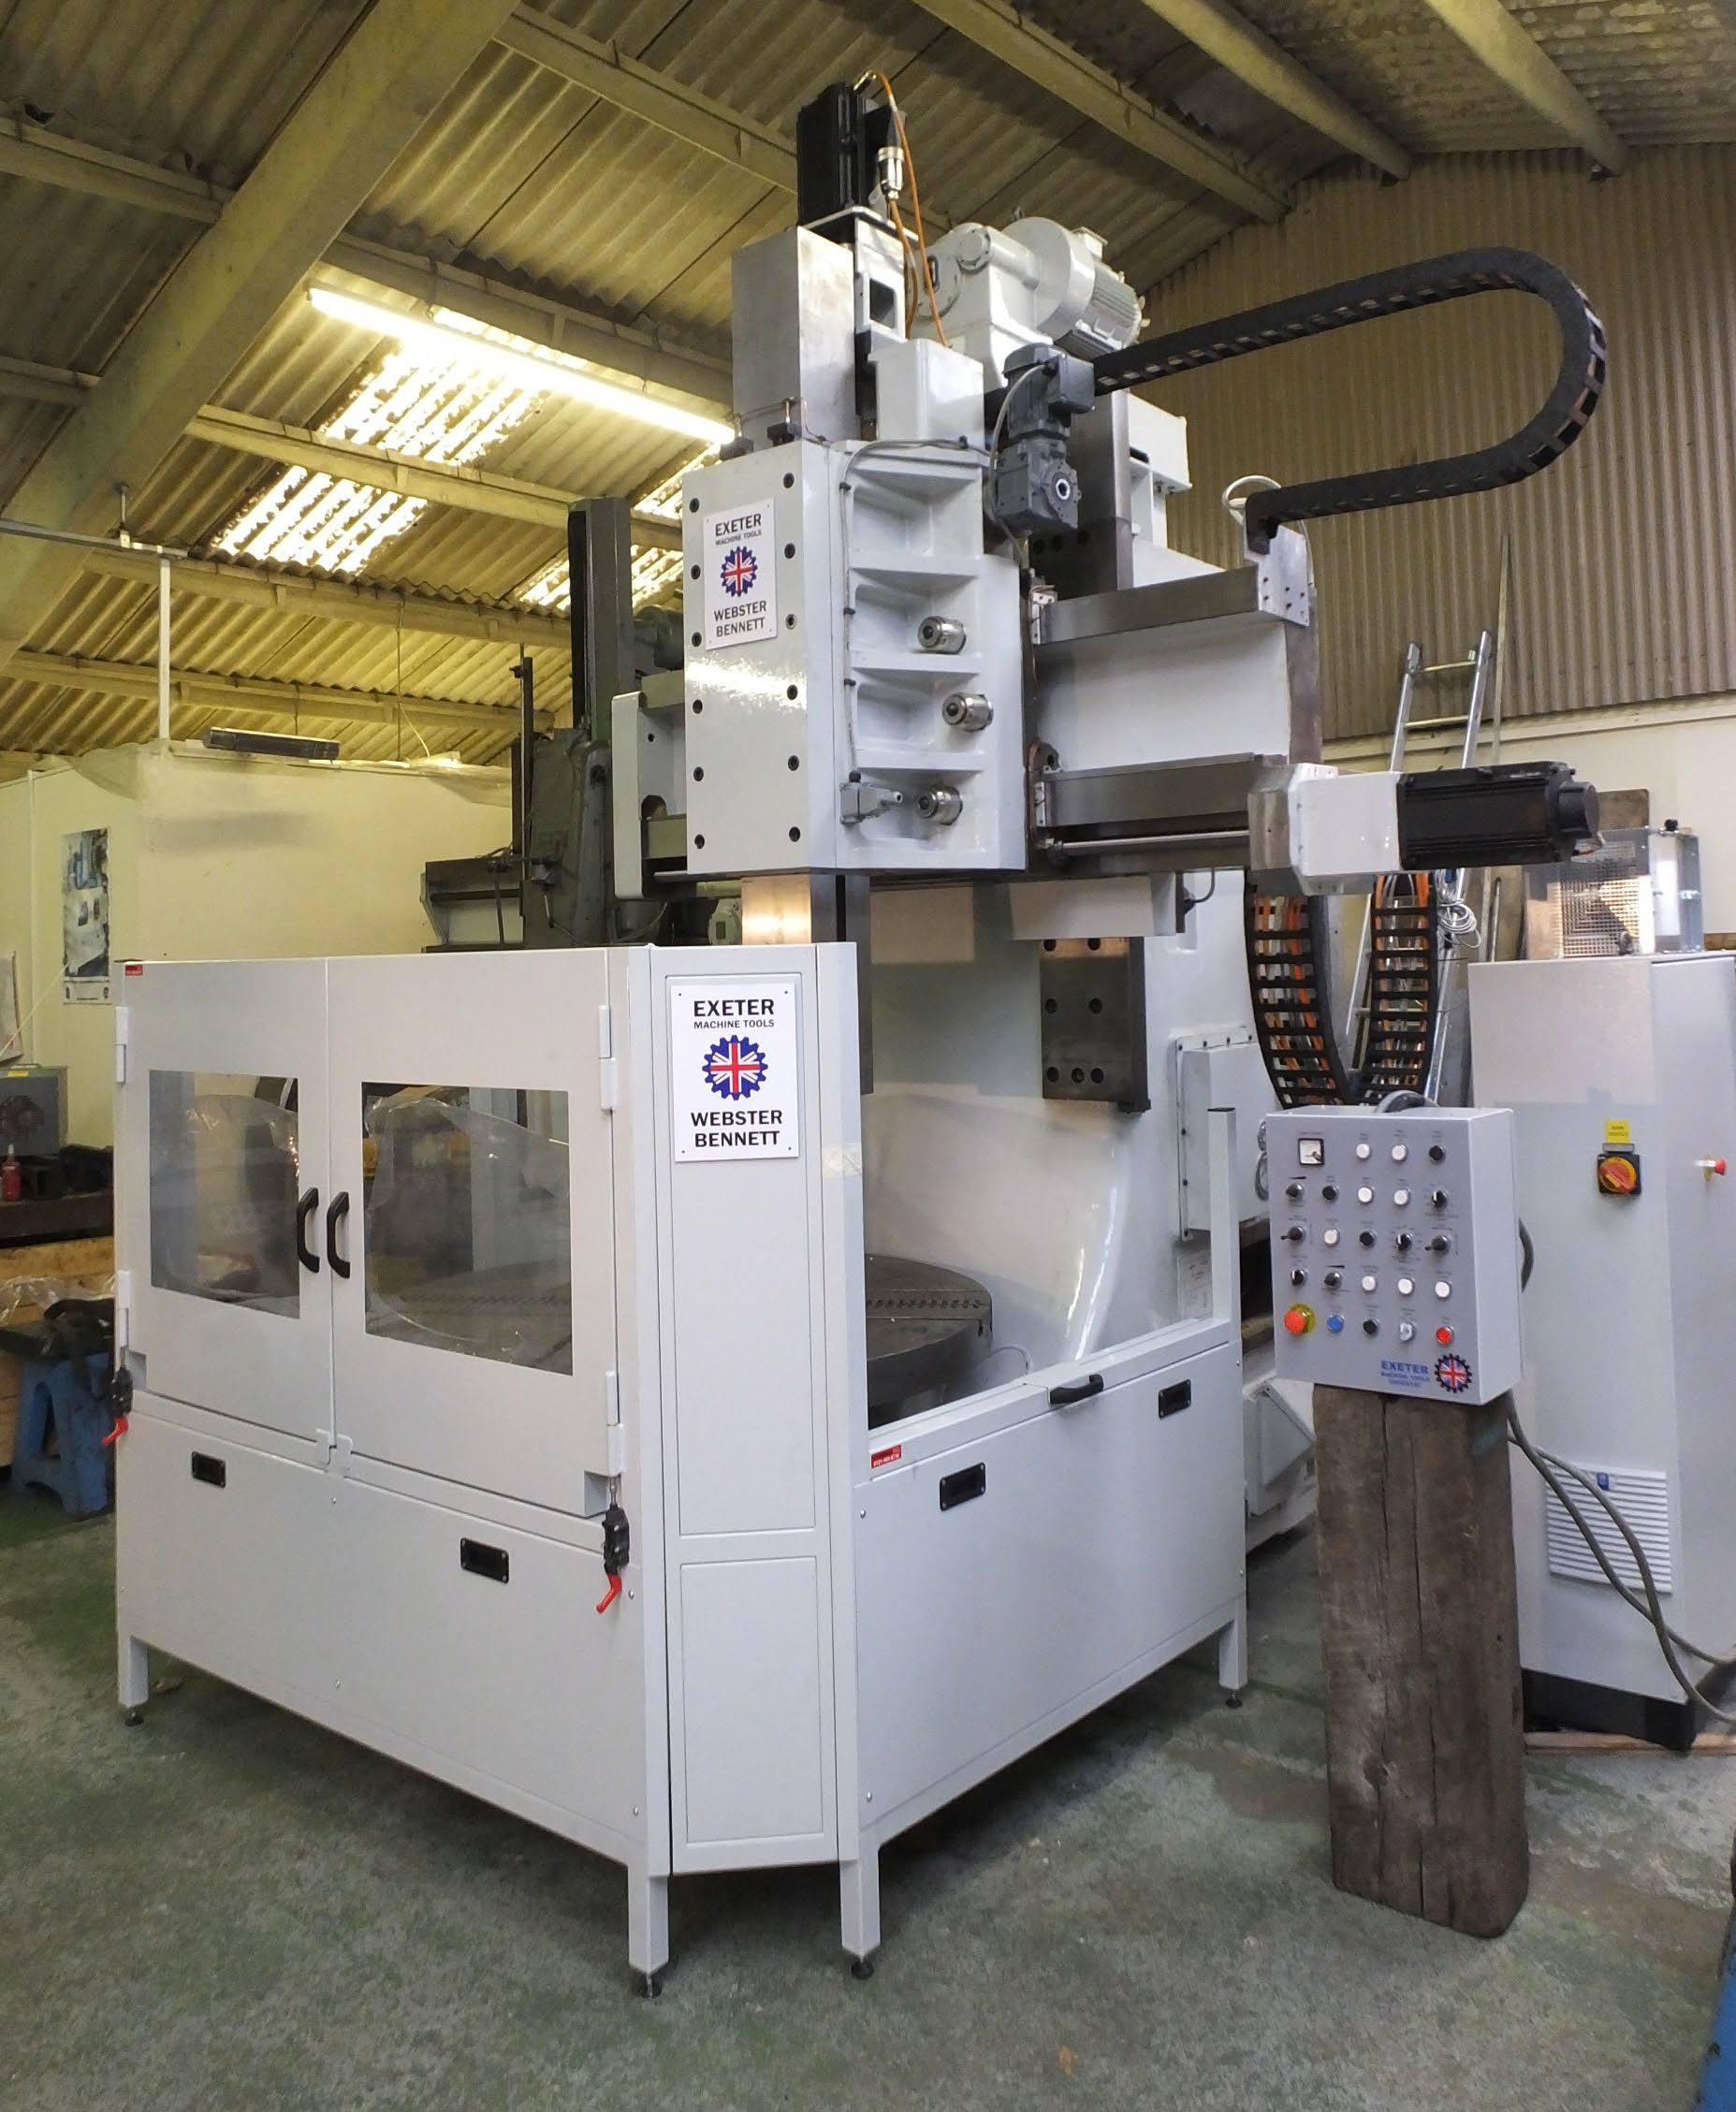
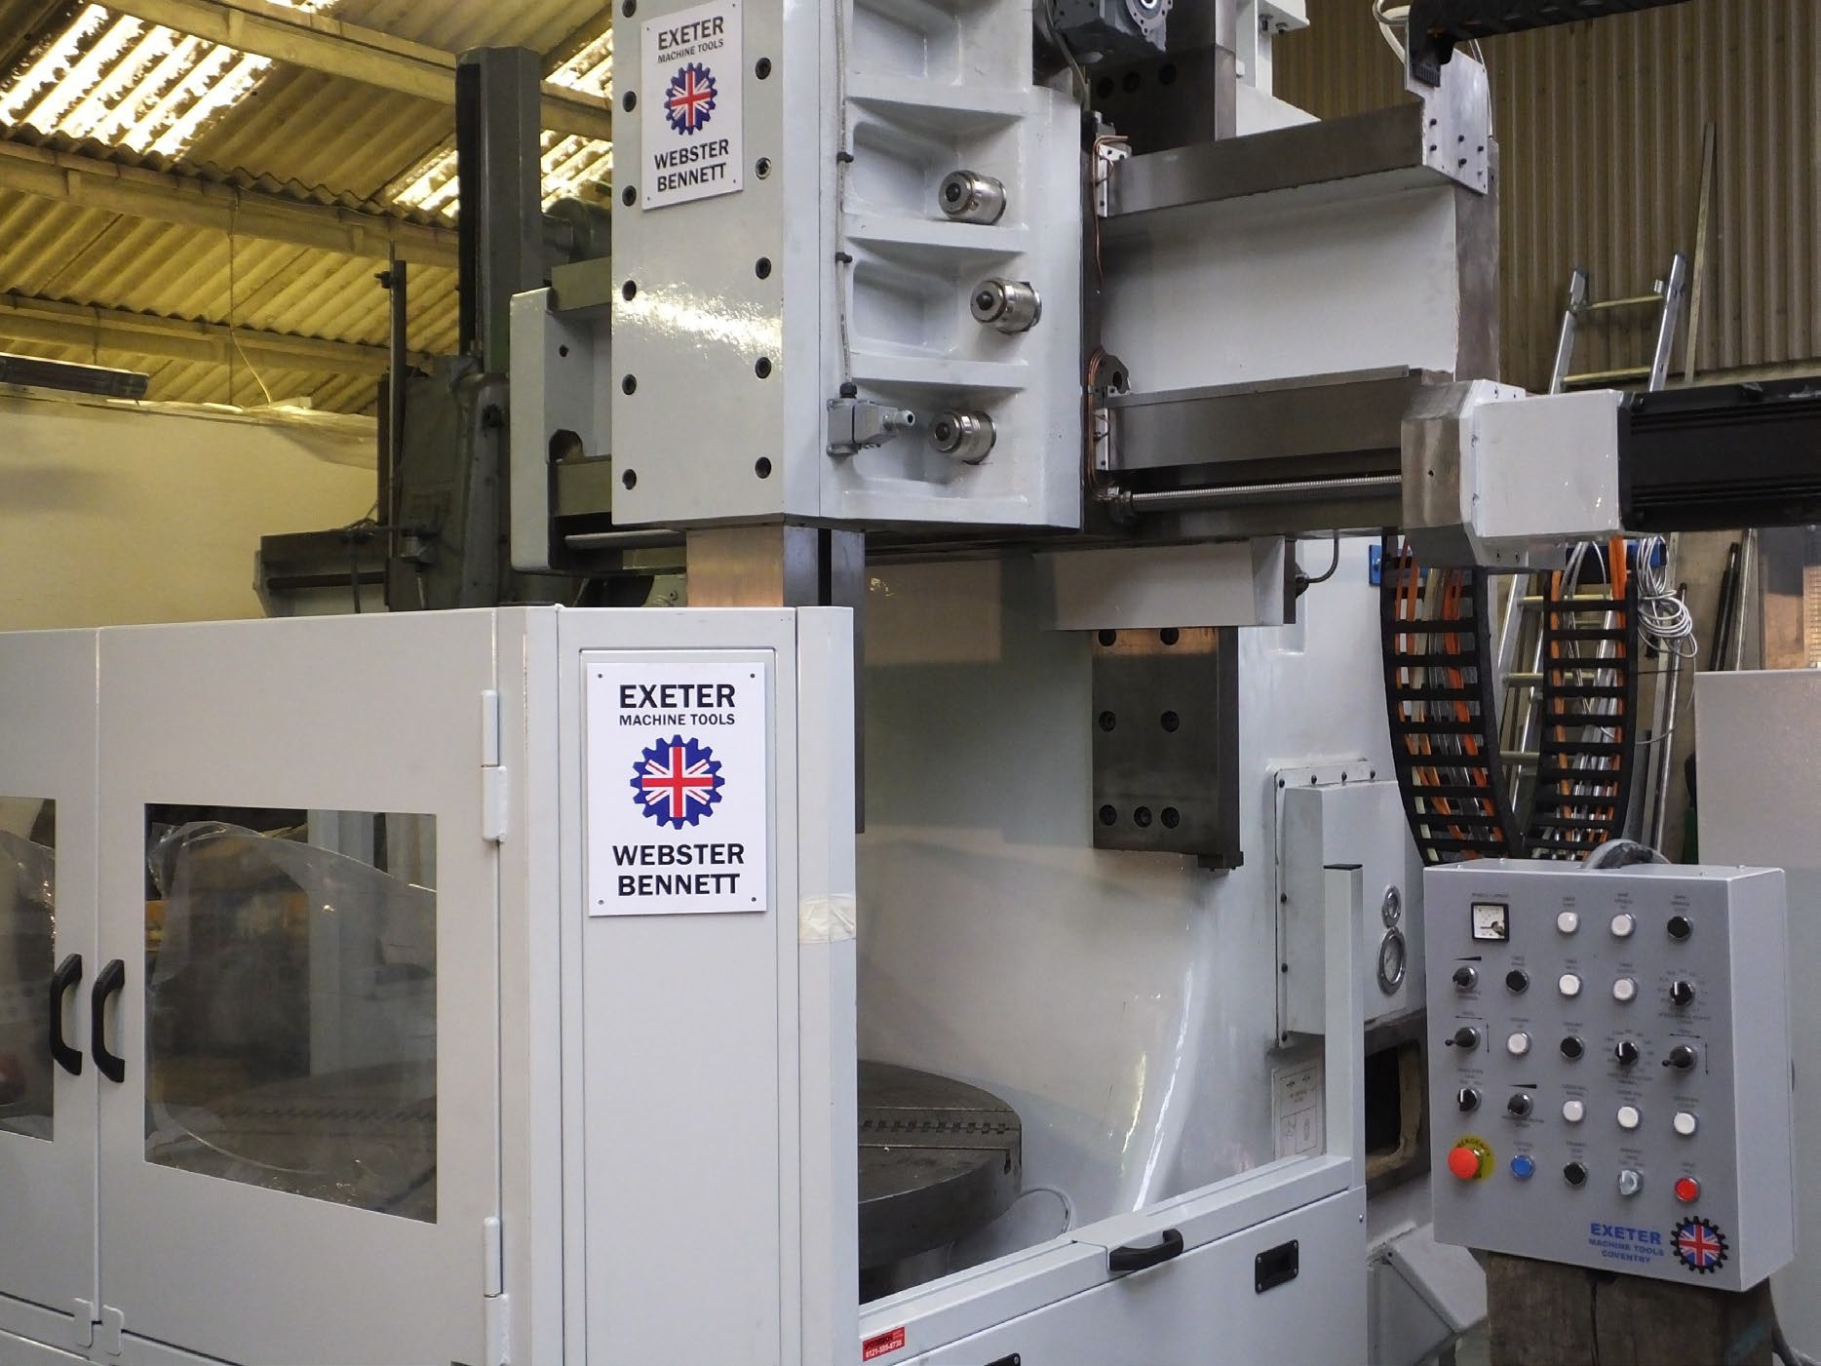
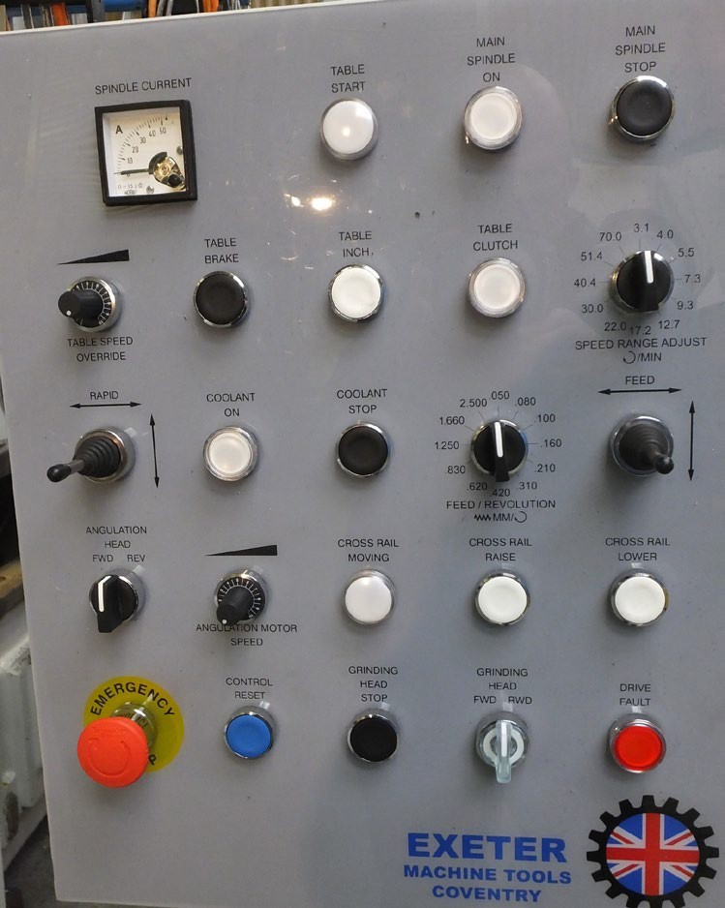
In 2014 we configured a ManuPlus that in addition to the table variable speed control has the benefits of ballscrew conversion to the axes, but especially new is the control of the ram swivel axis. From his pendant the operator controls the unclamp swivel setting and re-clamp.

Slide 8
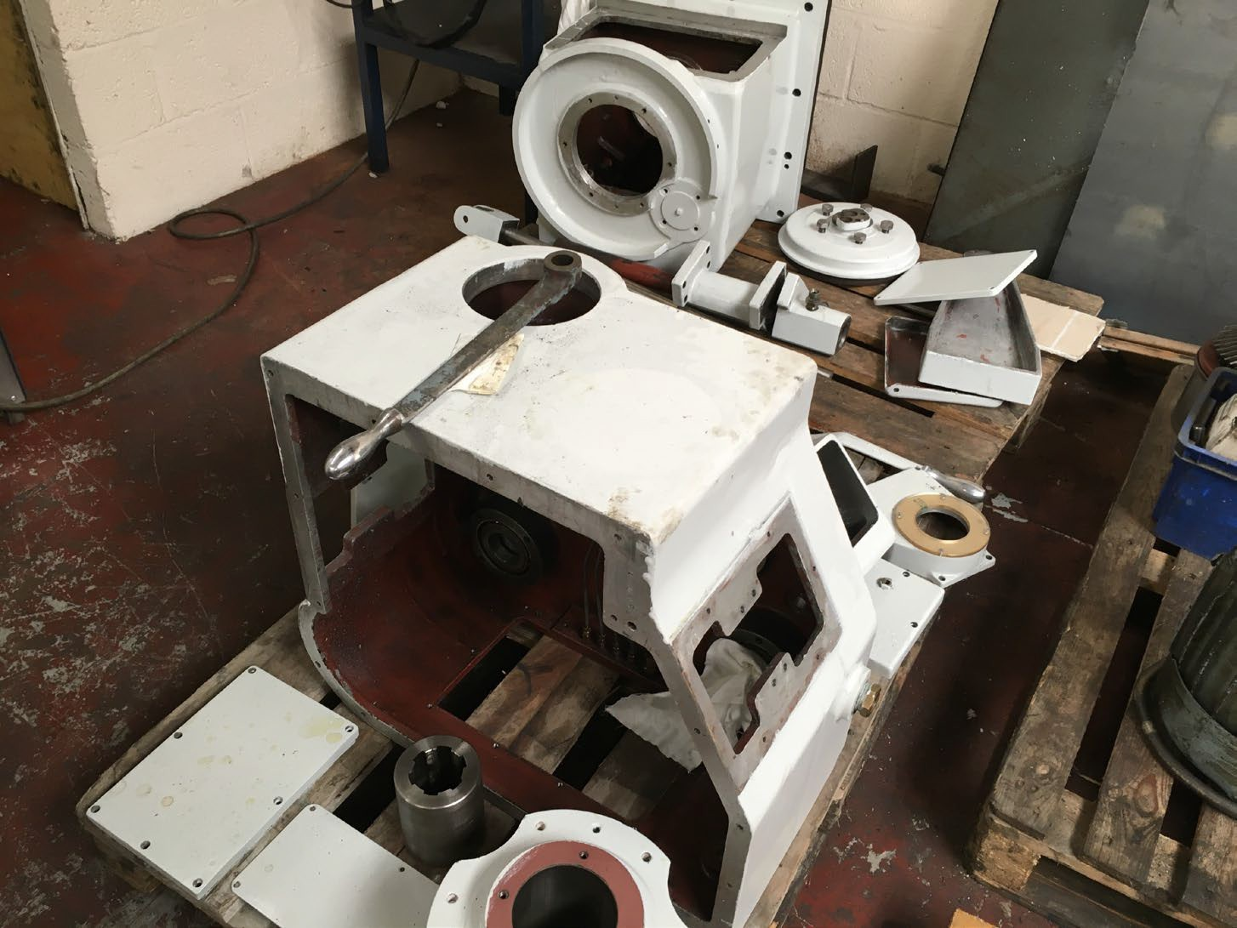
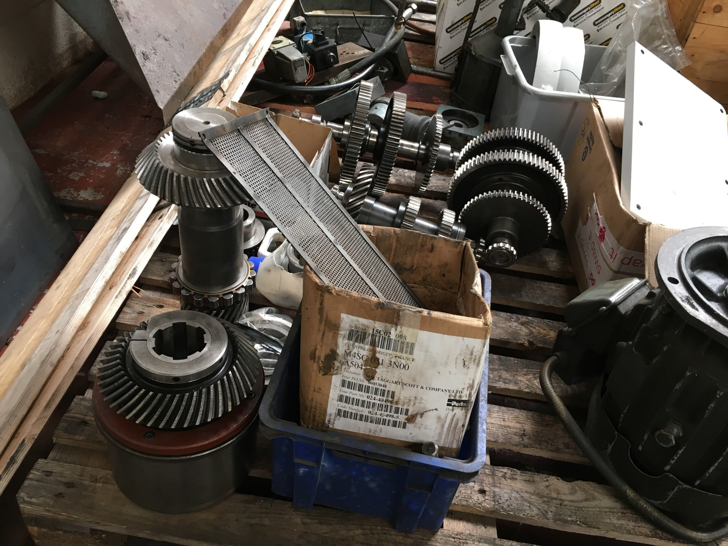
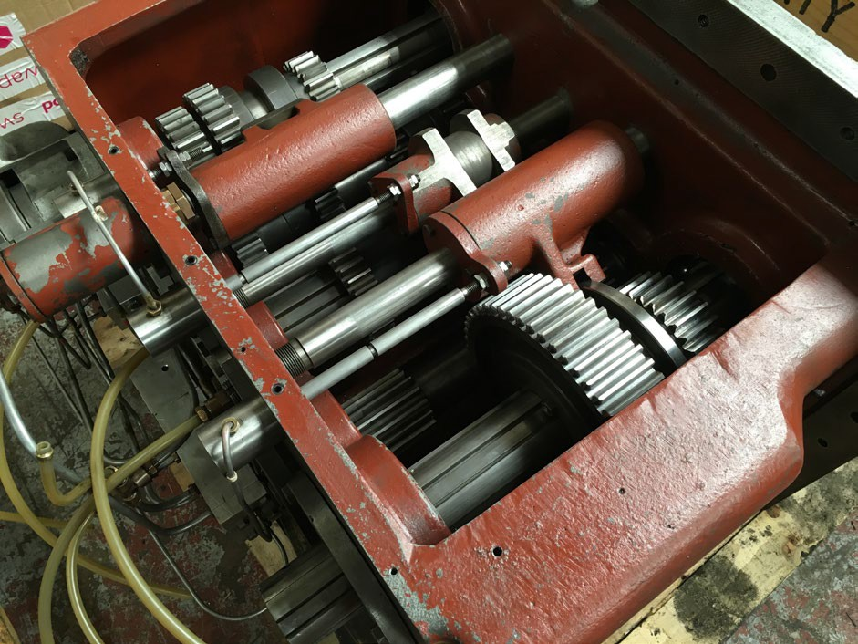
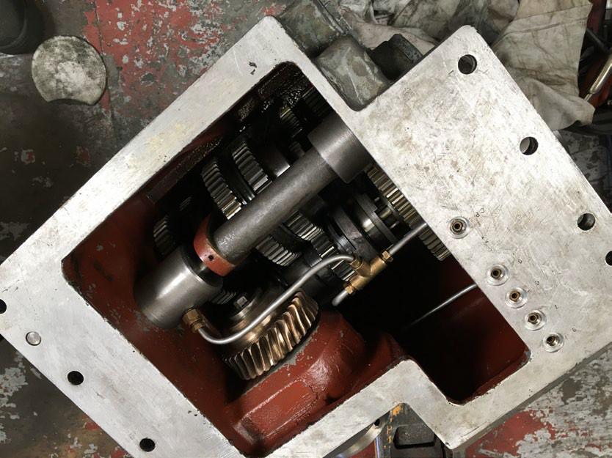
Of all the parts seen here only the spiral bevel gears may be re used. Contact us if you see spare parts like this that you might need

Slide 9
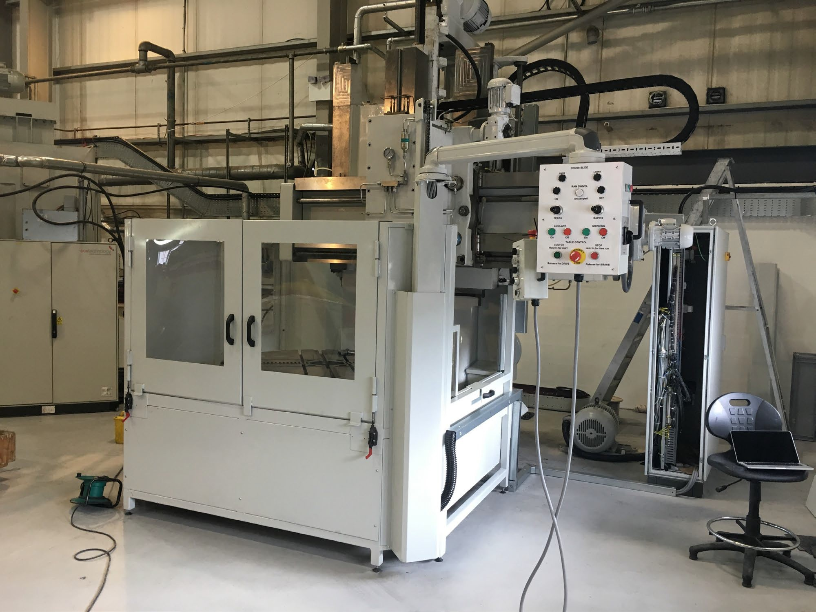
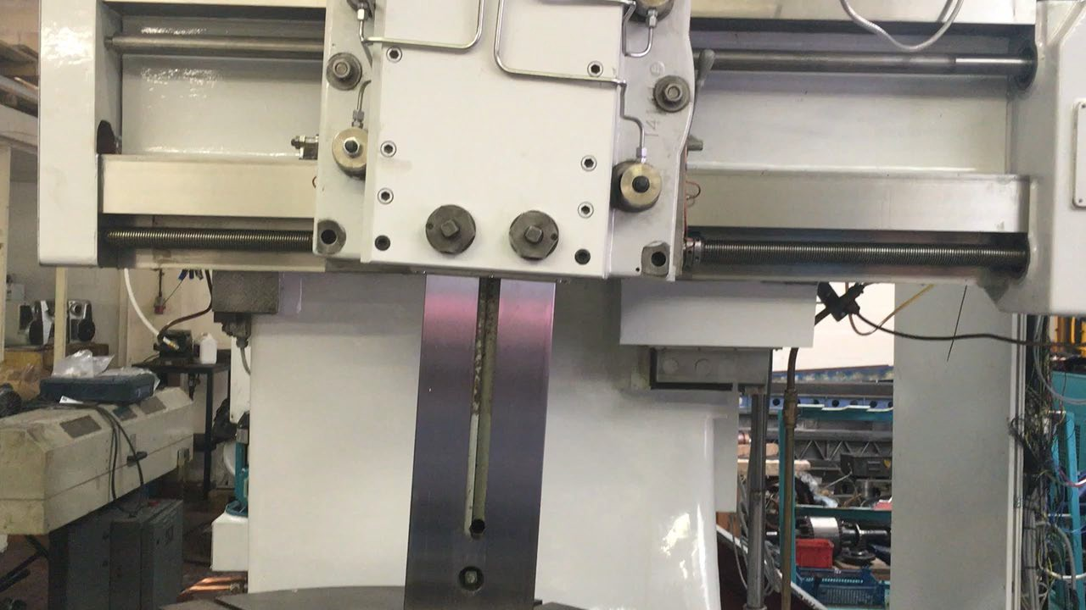
In 2015 we installed another swivelling ram option and upgraded a more basic machine. Click on the photo on the right just to see the smooth swivel movement. Clamping and un-clamping is automatically controlled by the operator from his pendant.

Slide 10
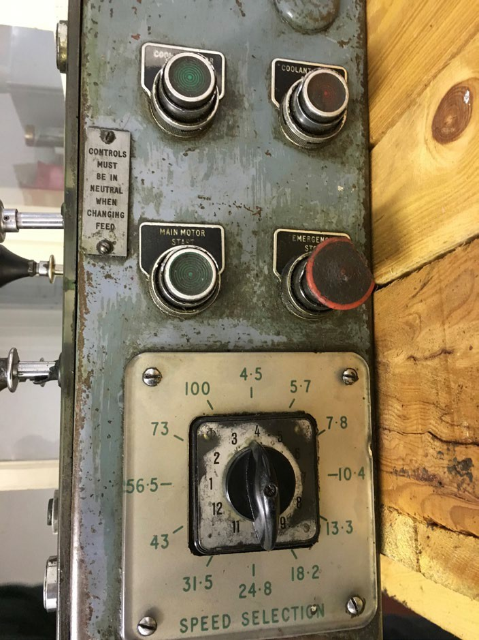

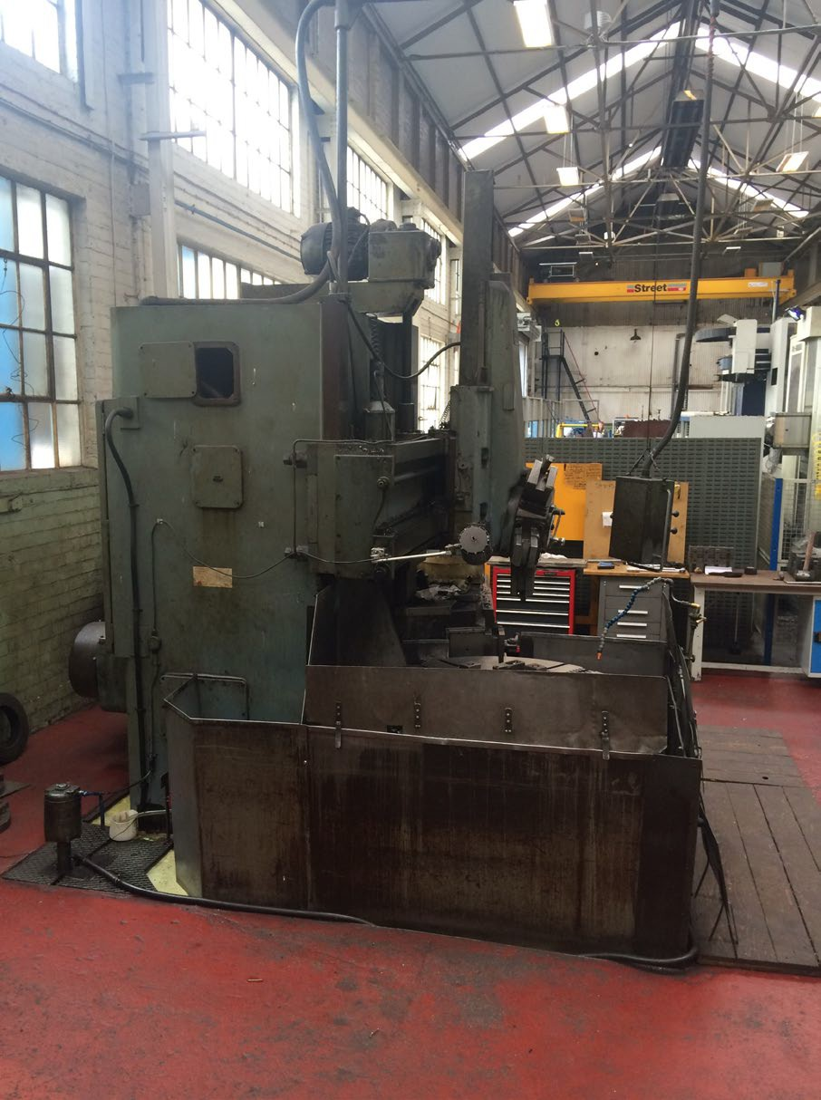
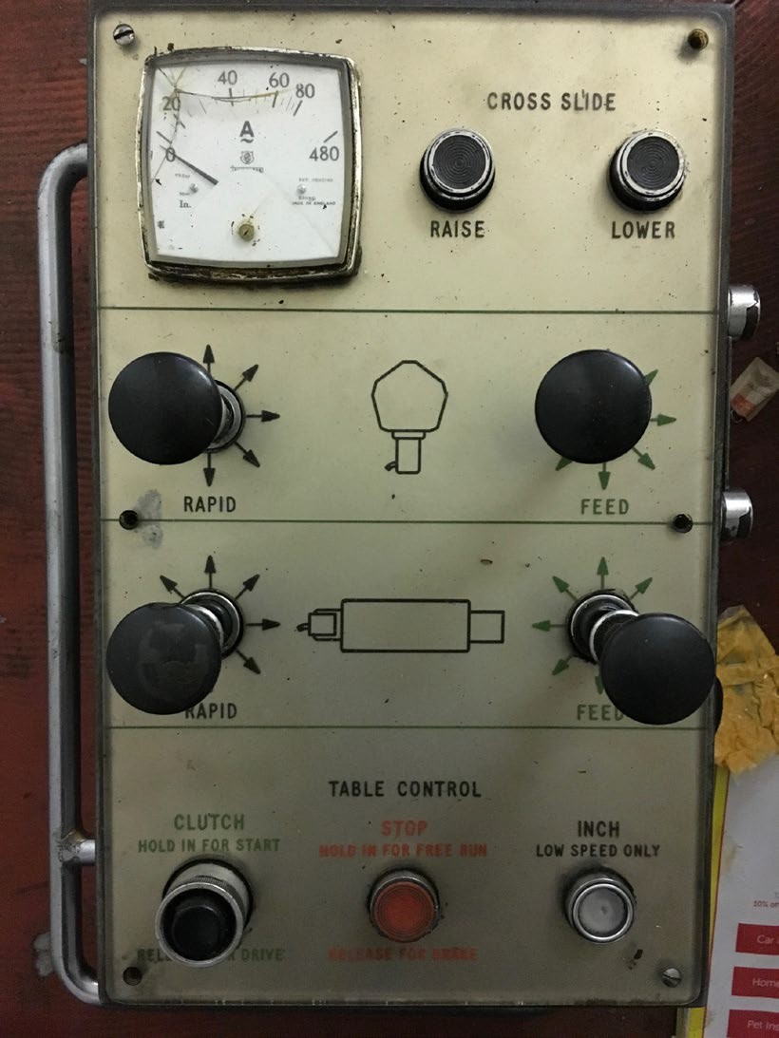
In 2015/2016 we had the opportunity to bring this machine into a specification and condition so that it could work for another 50 years.
The machine was a W&B 54Q with a side head and pendant control.
It was an advanced machine at the time of its original build.

Slide 11

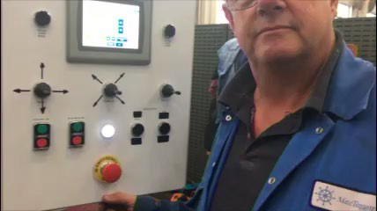
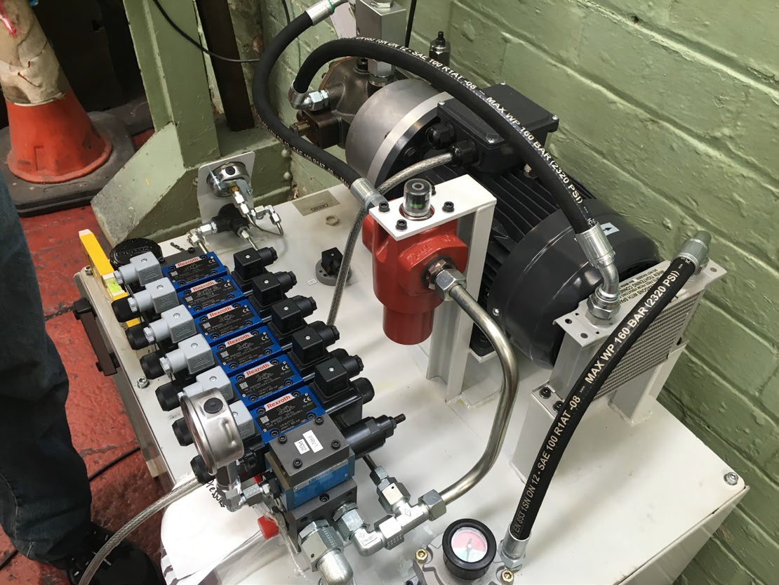
The W&B 54Q was converted to a machine that the operators could take a new pride in and gave them speed control and feed and creed feed control with excellent sensitivity. Some of the old hydraulic problems were solved with the installation of a new design hydraulic package. Click on the top right photo to see the film of the operators first contact with the machine during testing.

Slide 12
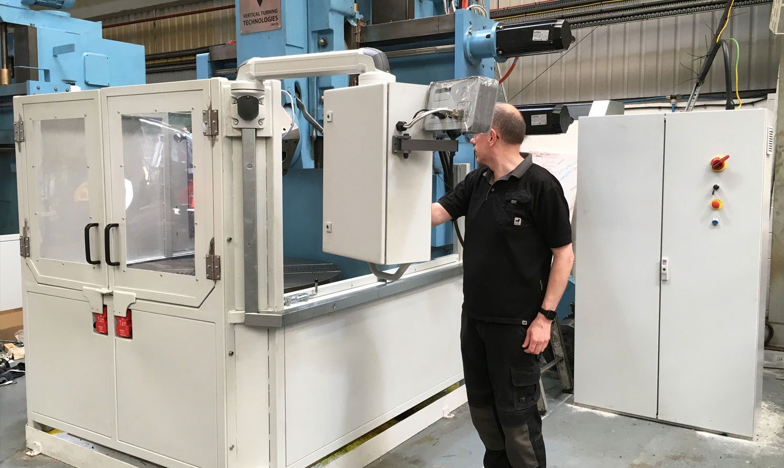
New technologies were allowing The MANUPLUS to become close to CNC capability. CNC prices and controllability were making a CNC Manuplus the likely choice for many future customers.
These two machines were the last PLC software controlled machines

Slide 13
The ManuPlus program now offers a ManuPlus-CNC option
The first MANUPLUS-CNC
Always ready for a challenge we took on the challenge to develop a large Double Column machine into a twin ram machine with extra height capacity and a longer, 1500mm, ram stroke
The year old donor machine may not look great but look how it looks now after being installed two years ago

Slide 14
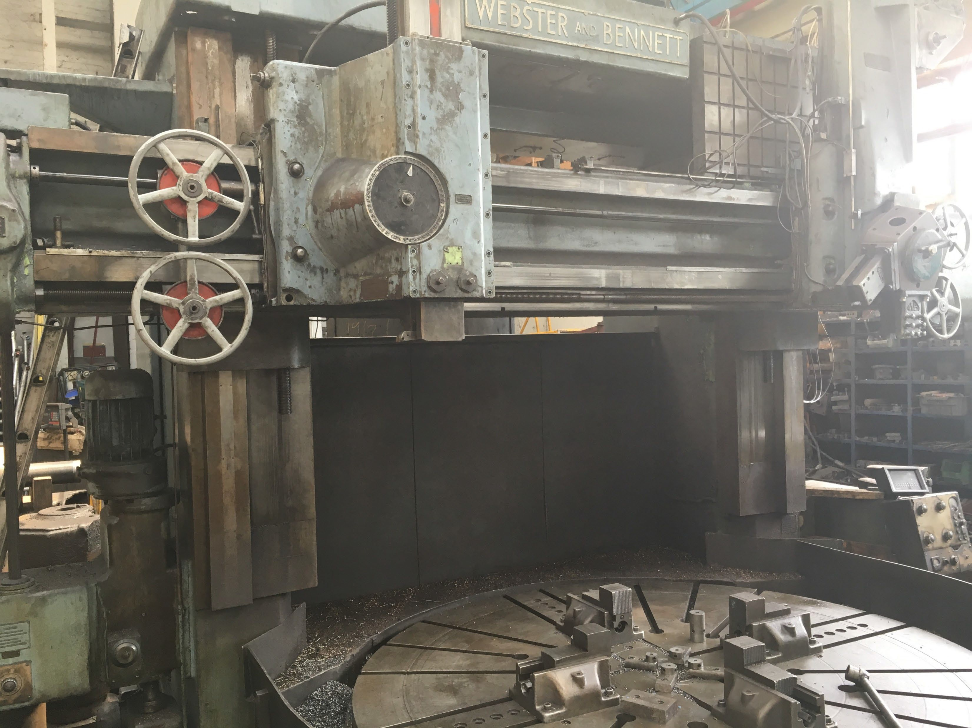
A donor Webster & Bennett 120” Double Column machine waits for its VTT-WB CNC revival

Slide 15
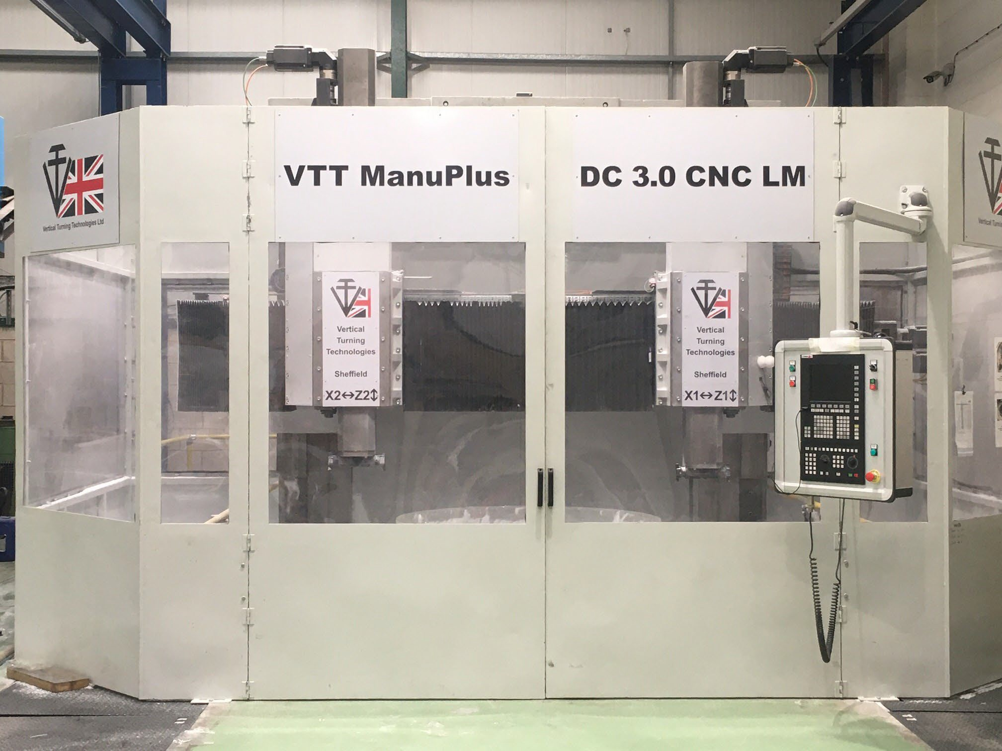
Revived!

Slide 16
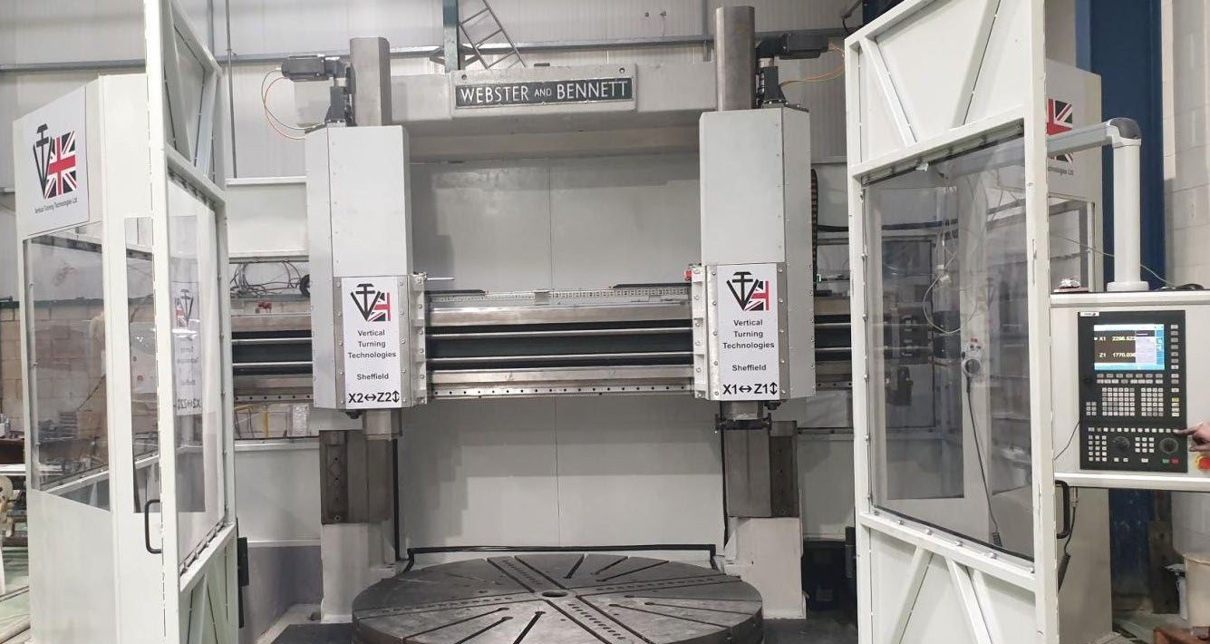
What a result! Linear guides for super smooth turning

Slide 17
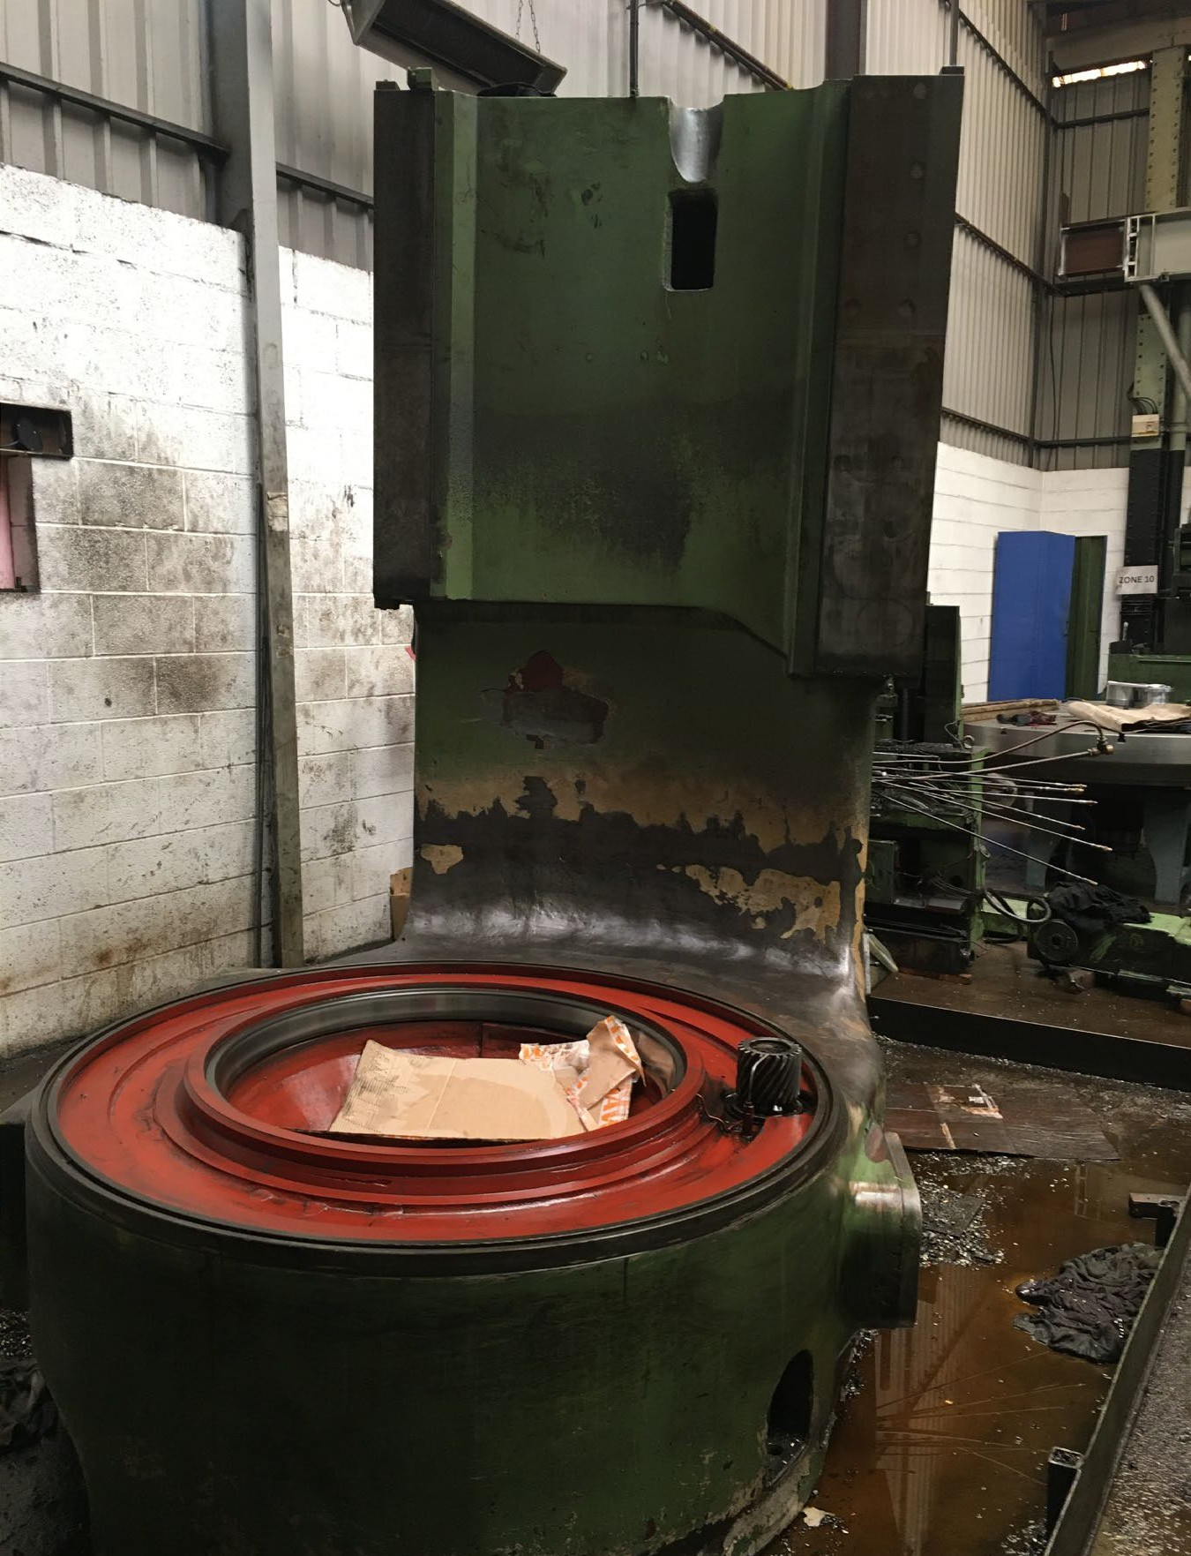
A very popular Webster & Bennett is the 72” machine equipped with the 90” chuck. The 72/90 below in process of being stripped for VTT-WB CNC revival

Slide 18
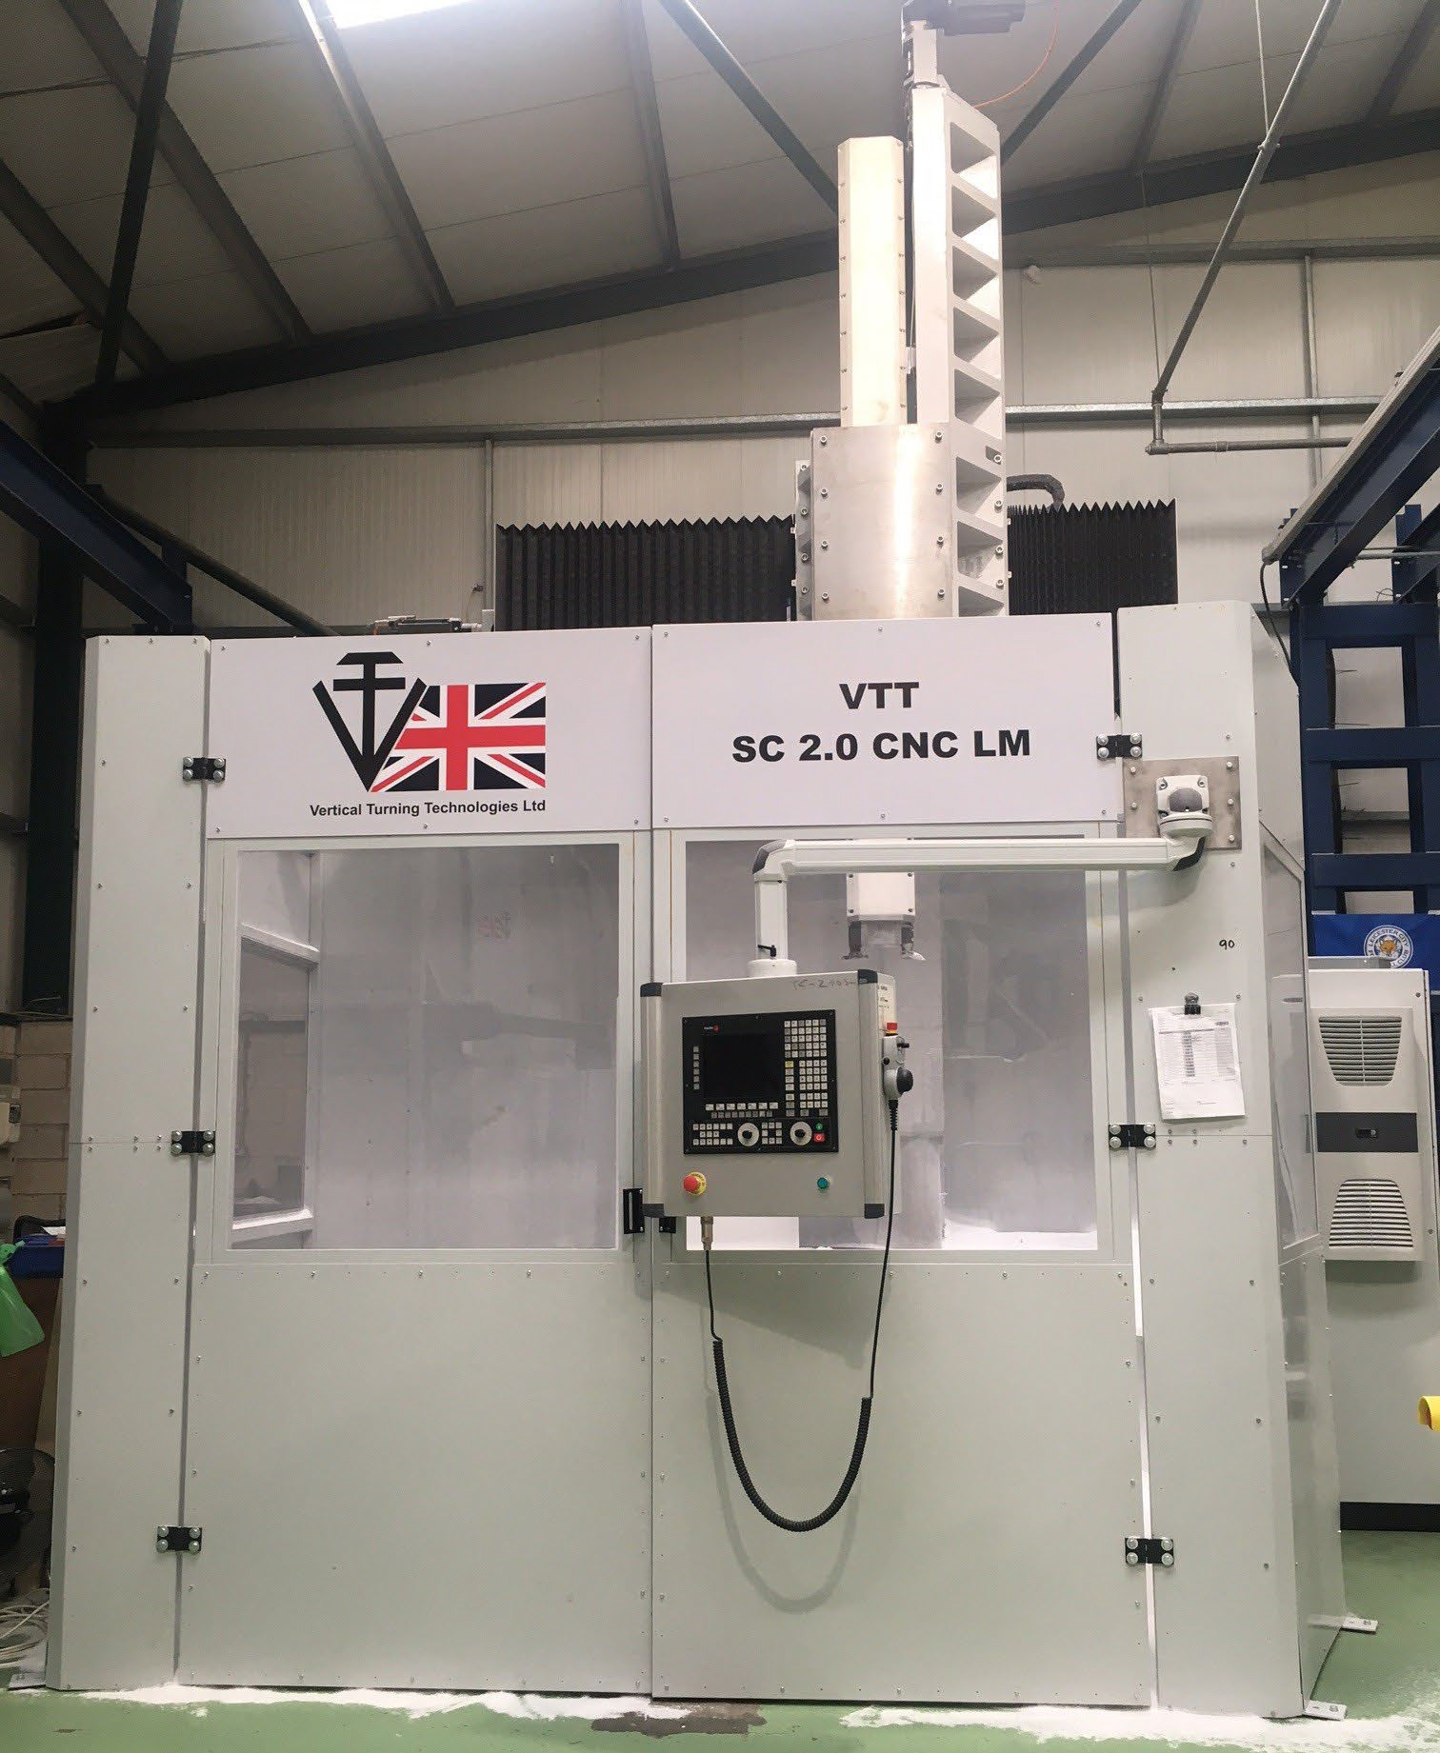
REVIVED. A
600mm height extension and a totally new ram with a 2m ram stroke!
Longer than the DC3.0 LM!

Slide 19
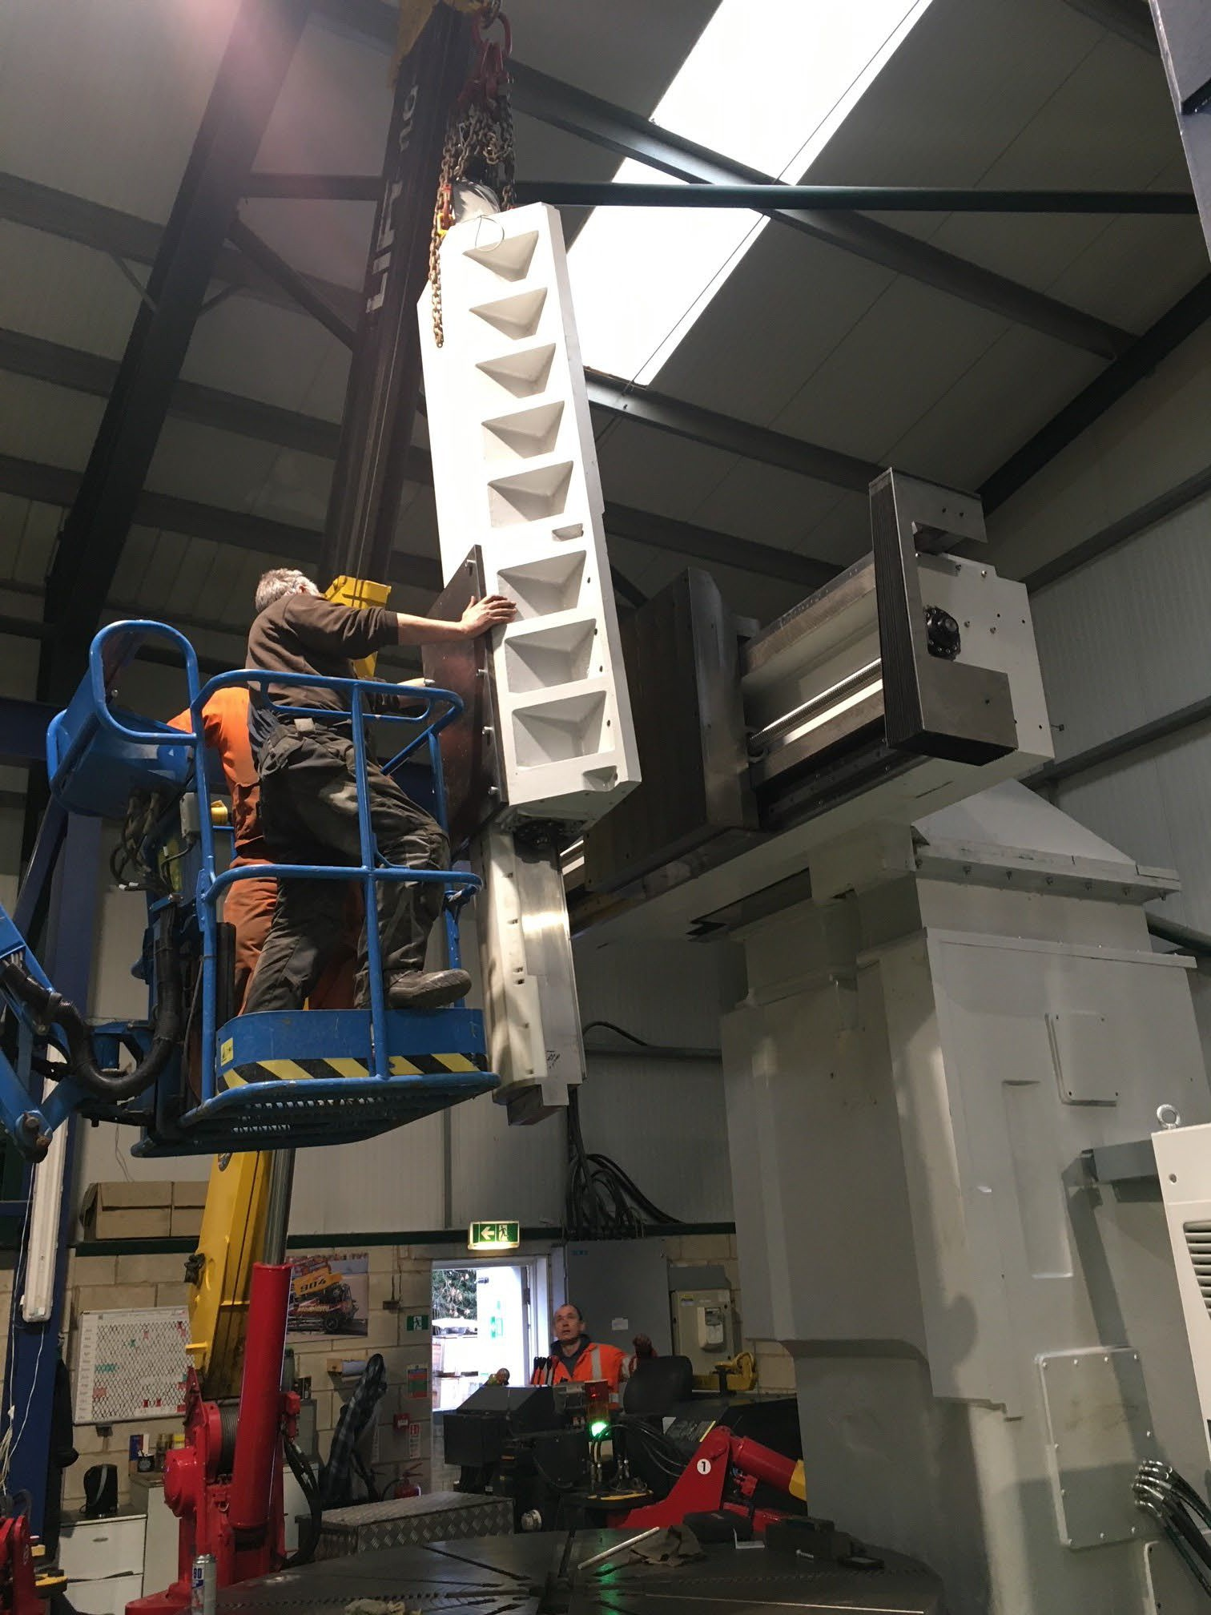
A 2m ram is big!
It needs super care on assembly
Just the job for VTT-WB

Slide 20

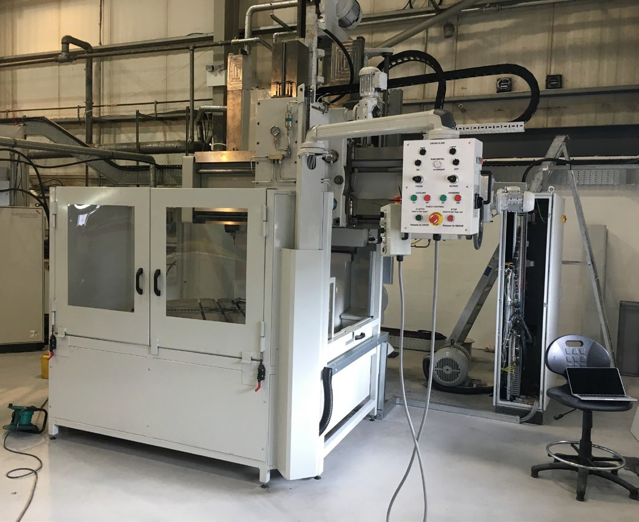


If this interests you please contact us – iain@vtt-wb.com
www.vtt-wb.com

